Slide 1
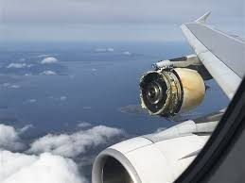
Flight Engineer
Aircraft Engine Anomaly and Fault Detection
Steven Fischbach
…the ‘Operational’ Data Scientist

Slide 2
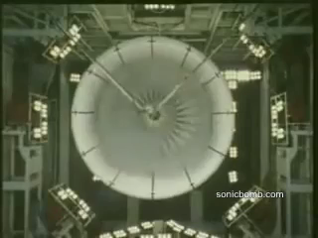
Planning to Avoid Failure
Failure is expensive!
Preventative maintenance
Scheduling timelines
Budget estimates

Slide 3
Data
NASA Dataset
Aircraft engine simulator
26 features
Randomized start
Operated until failure
15 measurements recorded once during a cycle

Slide 4
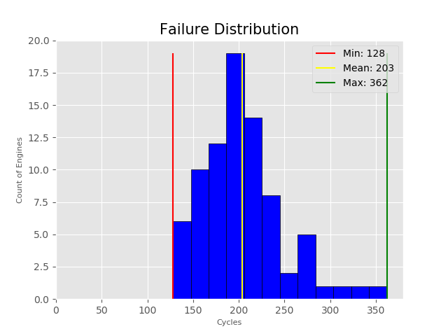
Once Per Cycle?
Cycle is one use of the engine
Cycle = startup + take-off + landing + shutdown
Time between startup and shutdown will vary

Slide 5
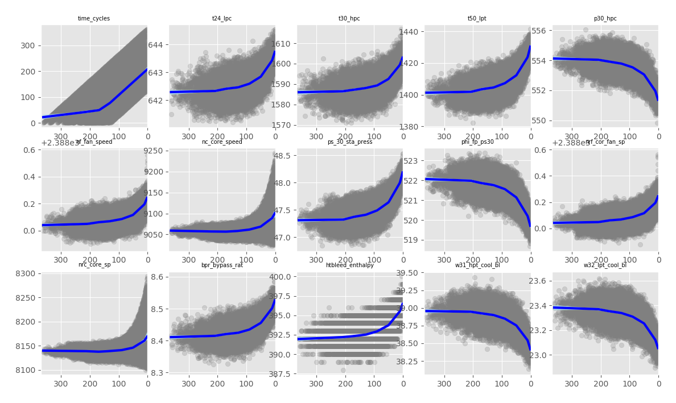
Predictive Features
Zero

Slide 6
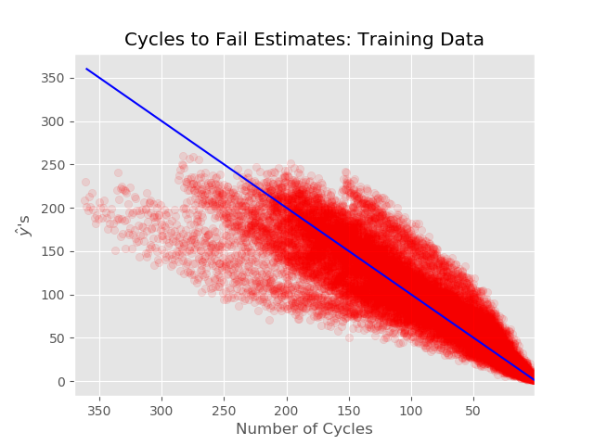
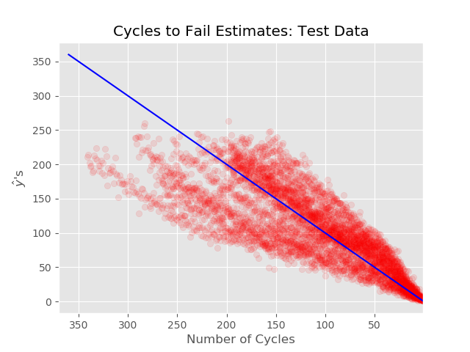
Results using knots and splines

Slide 7
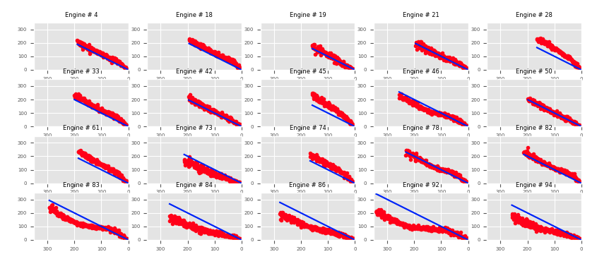
Current Results Using Test Data

Slide 8
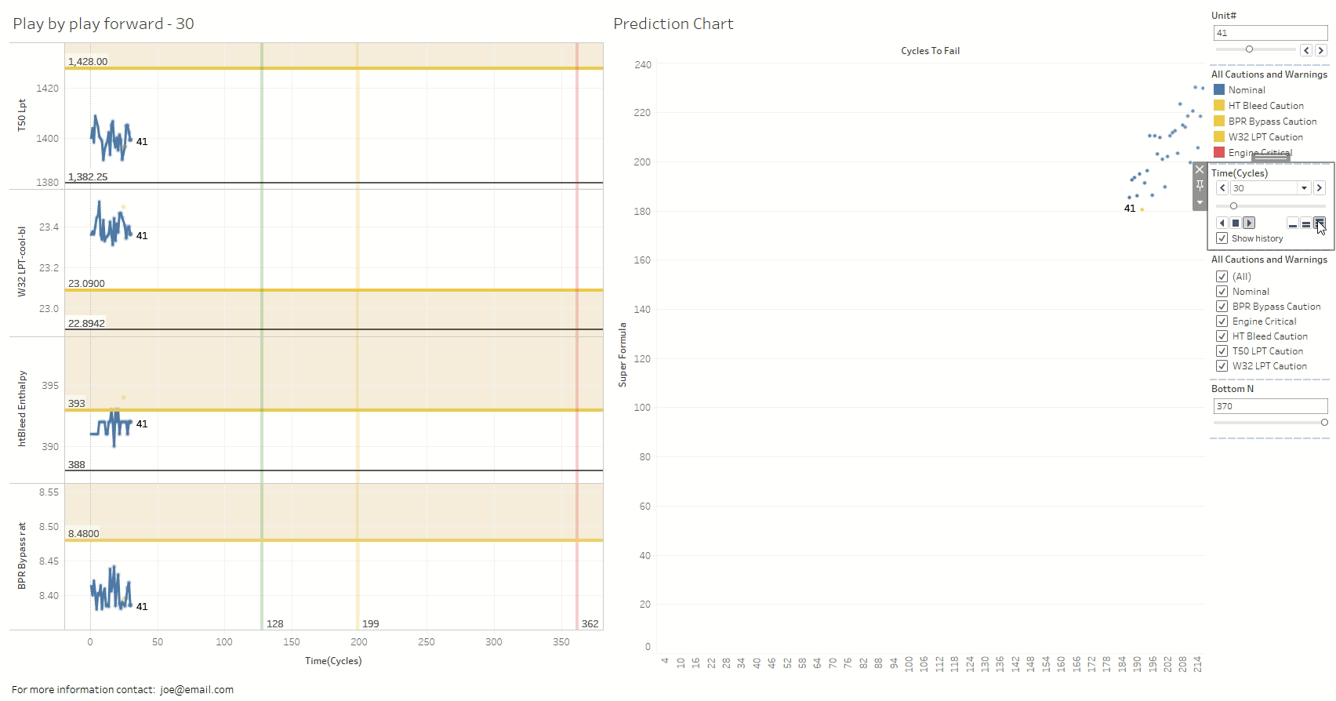

Slide 9
Future Work
More model tuning
Categorical analysis of short life vs long life
Output formula in Tableau format
Cost estimator vs safety margin
Statistical estimation of failure
Integration with scheduling tools

Slide 10
